Slide 1
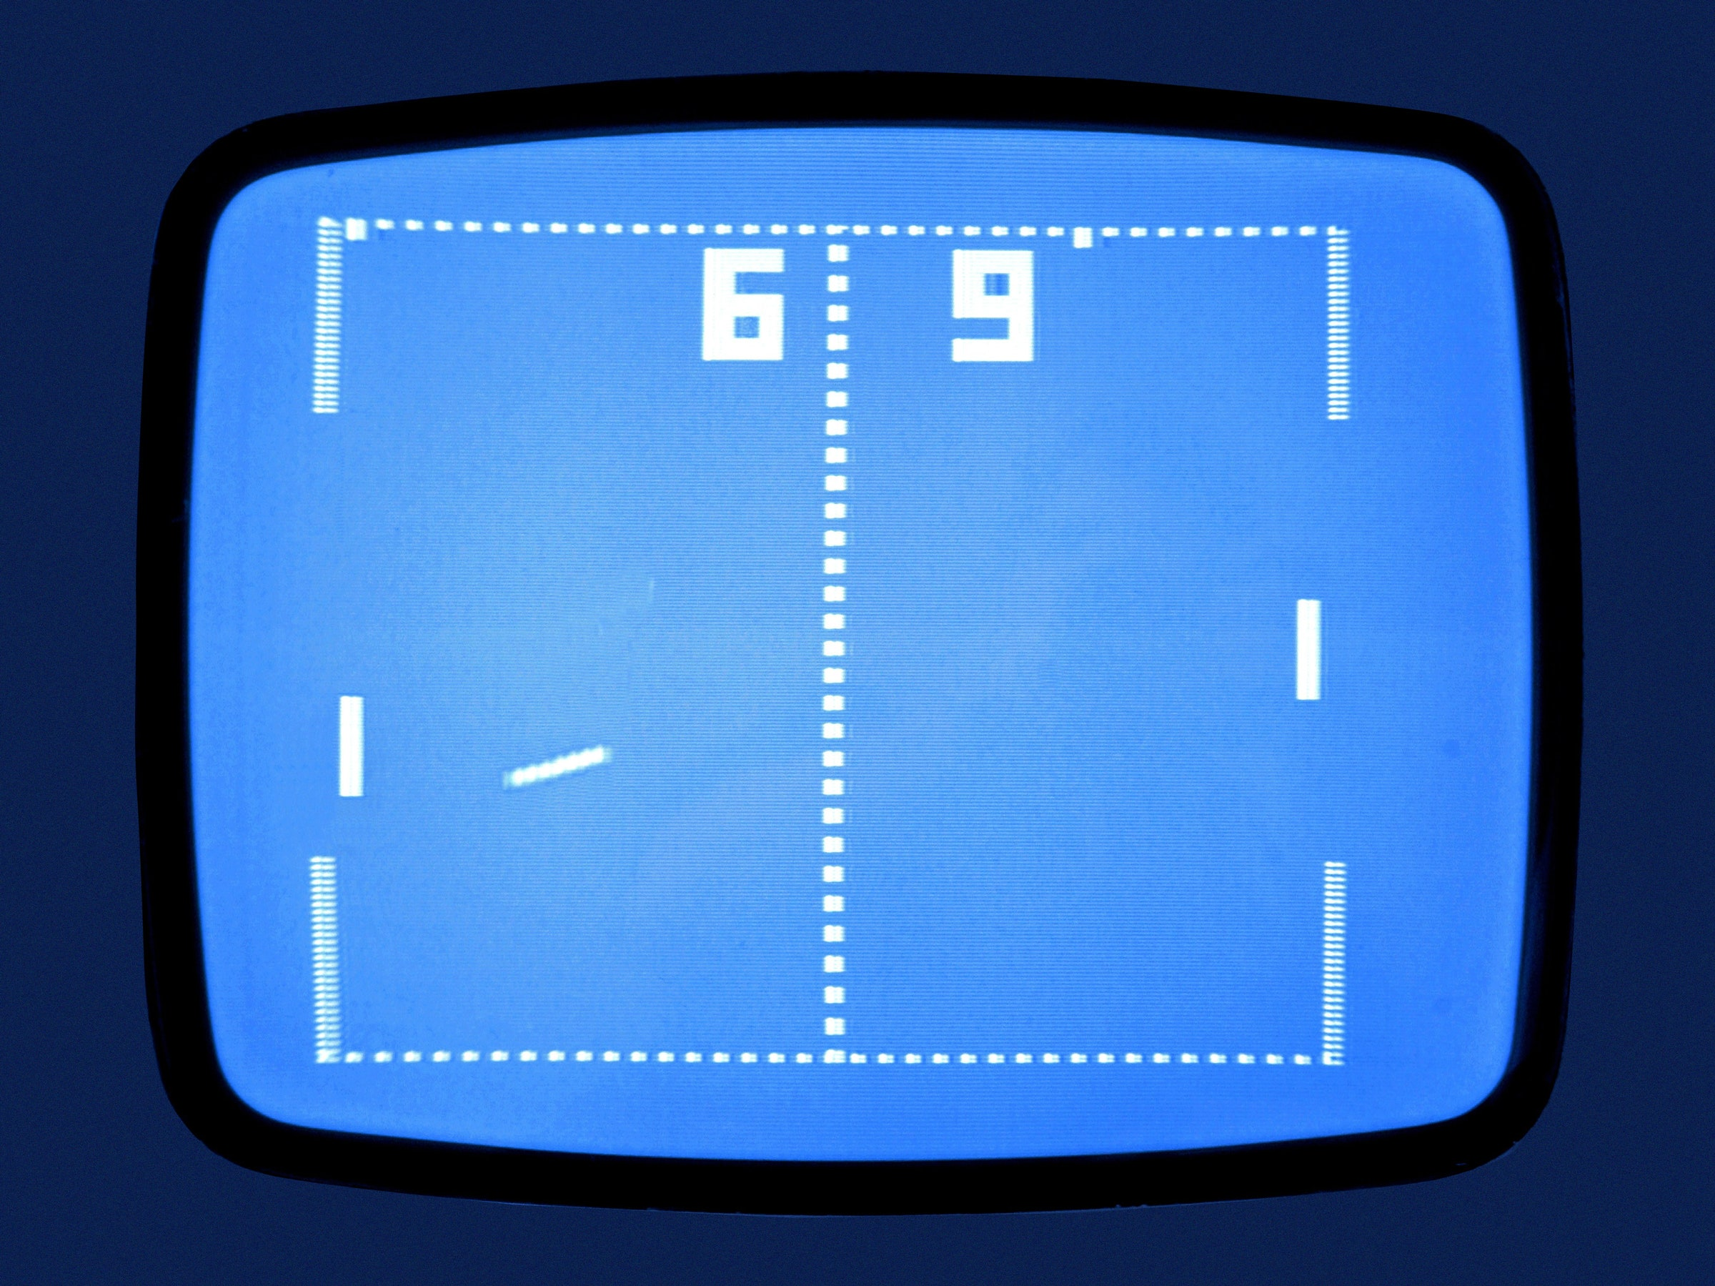
Python! Day 17
Create the Pong video game

Slide 2
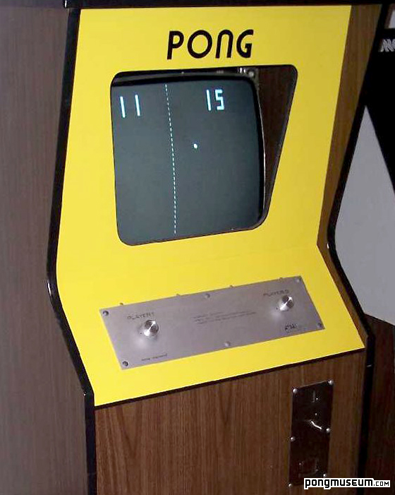
Project: Creating Pong
Pong is a video game where two players, or a player and a computer, play a version of virtual ping-pong against each other
Today, let’s work to recreate pong using Python
Pong is a more complex game than the snake game, so there will be many steps to this project

Slide 3

Steps to Create Pong
Create the screen
1
Create and move a paddle
2
Create another paddle
3
Create the ball and make it move
4
Detect collisions with the wall and make the ball bounce
5
Detect collisions with a paddle
6
Detect when the paddle misses
7
Keep the score
8

Slide 4
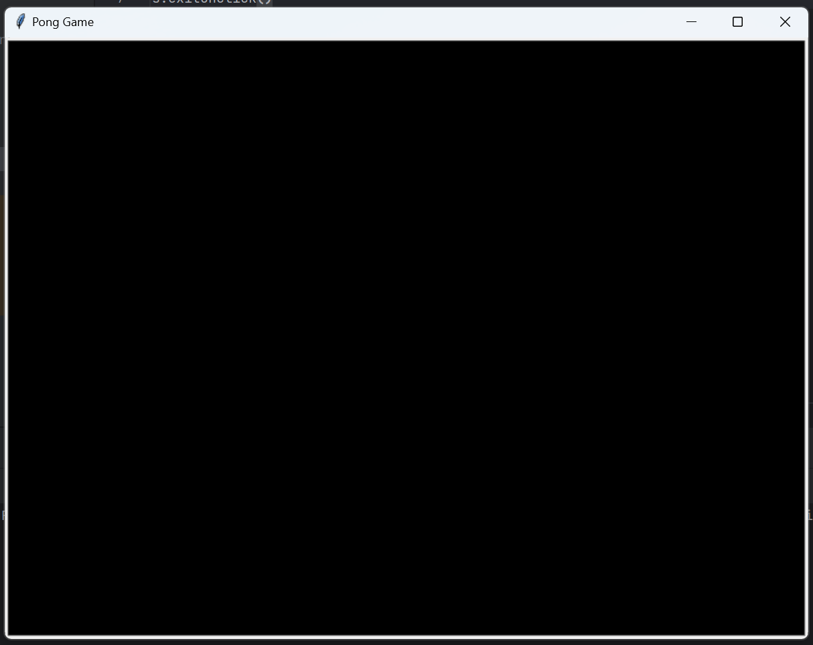
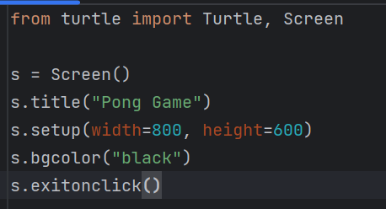
Step 1: Creating the Screen
Let’s start by creating a new project and setting up the game screen in our main.py file
The screen should be 800 wide and 600 tall with a black background

Slide 5
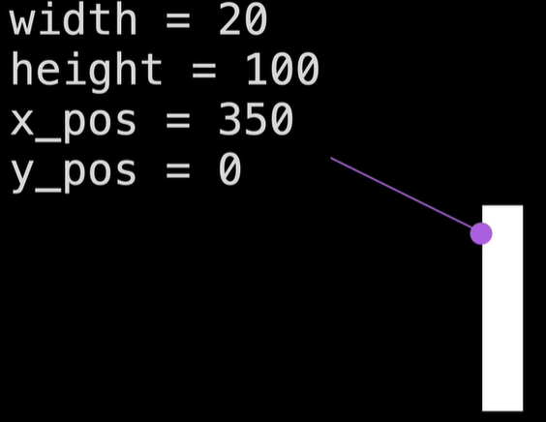
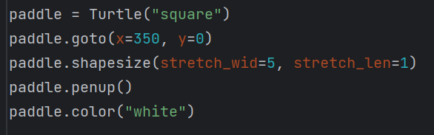
Step 2: Create a Paddle
Next, let’s create our ping-pong paddle
We want our paddle to be 20 wide, 100 tall, color white, and with an x position of 350 and a y position of 0
For now, we’ll create our paddle in our main.py file, and we’ll create out paddle class later

Slide 6
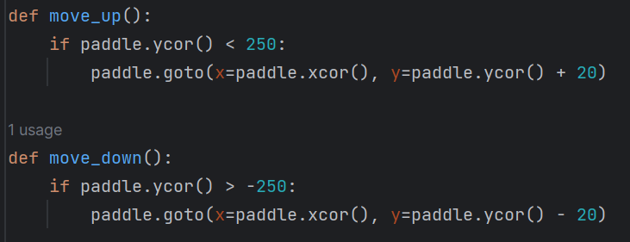
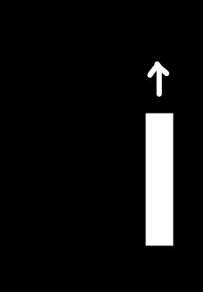
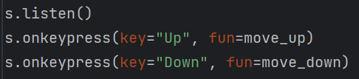
Make the Paddle Move
Just like with our snake game, we want to be able to move our paddle up and down using the arrow keys
We can do this using the screen.listen() and screen.onkeypress() methods

Slide 7
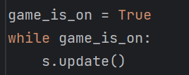
Fix the Paddle’s Animations
Currently, when we press play, we have to wait for the pong paddle to travel to the other side of the screen
To fix this, just like with the snake game, we need to control the animations of the pong game
We can do this by setting the screen updates manually by writing s.tracer(0) at the start of the program and writing s.update() whenever we want the screen to update
Let’s update the screen inside a while loop that plays if the condition game_is_on = True

Slide 8
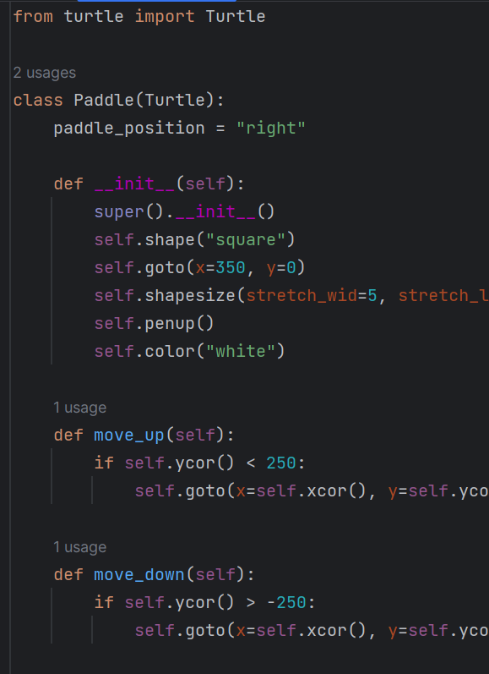
Step 3: Create Another Paddle
To create more than one paddle, let’s create a paddle class
To do this, we’ll create a Paddle class in a new Python file, and we’ll move all our paddle code from our main.py file to our new paddle.py file
Let’s also make the paddle class inherit from the Turtle class
Then, we can replace our code in our main.py file by importing our new paddle object

Slide 9
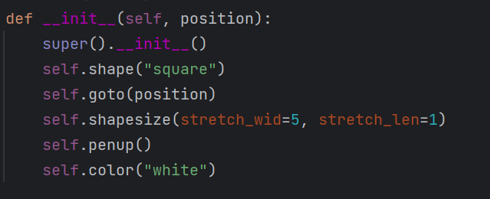
Adding Inputs to Our Paddle Class
Right now, if we create a second paddle, both will go to the same location at the right of the screen.
We want to send one paddle to the left of the screen and the other paddle to the right of the screen
We can make both of our paddles go to different locations by adding an extra input to our __init__() function called position and use this input to change where the paddle goes
Then, we can set the value of this position variable in our main.py file like this:
right_paddle = Paddle((350, 0))
left_paddle = Paddle((-350, 0))

Slide 10
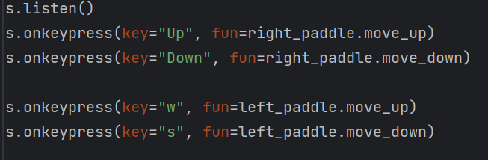
Controlling Each Paddle Individually
Finally, we can control each paddle individually in our main.py file
We can use “w” and “s” to move the left paddle up and down and use “Up” and “Down” to move the right paddle

Slide 11
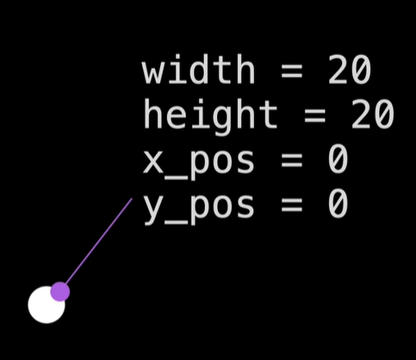
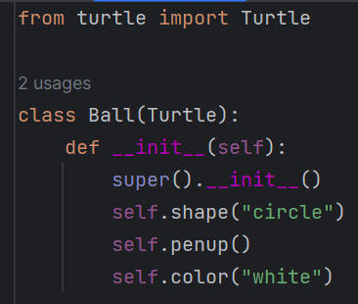
Step 4: Create the Ball and Make it Move
Now, let’s create the ping-pong ball
To do this, we can start by creating a ball class that inherits from Turtle
In the __init__() function, we can make the ball a white sphere

Slide 12
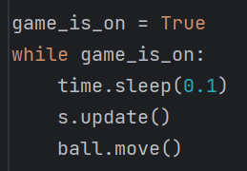
Making the Ball Move
To make the ball move, we can create a move function that moves the ball right and up by 10 pixels
Then, when we create a ball object in our main.py file, we can make it move continuously by writing ball.move() in our while loop
Now, the problem here is that the ball is way too fast
We can fix this by importing the time module and writing time.sleep(0.1) in our while loop to make the ball move slower

Slide 13
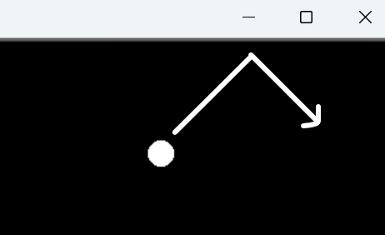
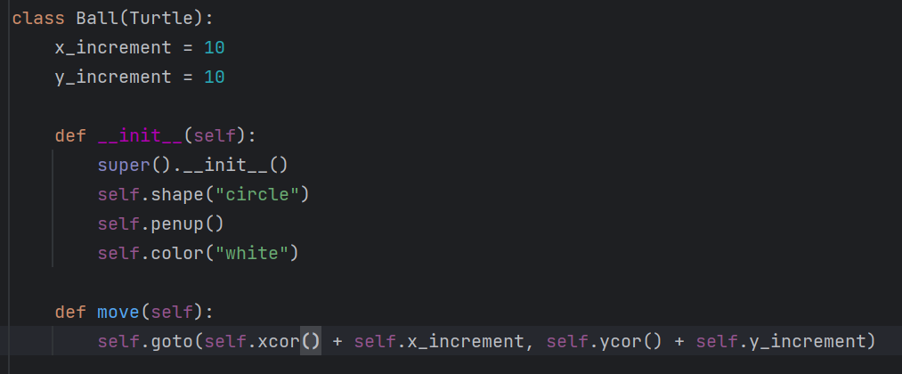
Step 5: Detect collisions with the wall and make the ball bounce
This part is where the game gets a little trickier, we need to make the ball bounce when it hits the top or bottom walls
To do this, in our ball.py file’s move function, let’s change how much we move the ball by to variables called x_increment and y_increment
Then, we can set both variables equal to 10 at the top of our class

Slide 14

Now, in our main.py file’s while loop, we can write an if statement that detects if the ball is colliding with the top of the bottom wall
Inside that if statement, we can multiply the ball’s y_increment by -1 to make the ball go down instead of up
This will make the ball bounce

Slide 15
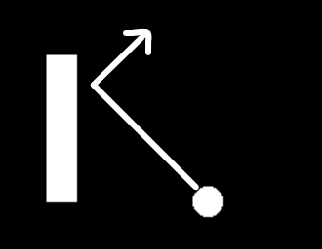
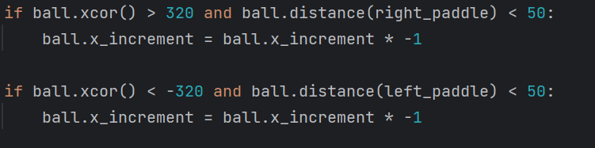
Step 6: Detect Collisions with the Paddles
In the snake game, we detected collisions between the food and the snake using the distance function
If we try doing the same thing in this game by writing “if ball.distance(paddle) < 20” we’ll have a problem, because this code would only detect collisions with the middle of the paddle, not the ends of the paddle
Try it out
Instead, a better solution is to detect if the ball’s x coordinate is around where the paddle is and detect if the ball is within 50 pixel of the center of the paddle

Slide 16

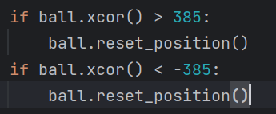
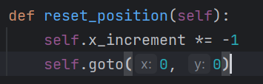
Step 7: Detect When the Paddle Misses
When the paddle misses and the ball hits the left or right wall, we want the ball to reset (go to the center of the screen) its position and move toward the opposite player
To make this happen, let’s write a method in our ball class called reset_position() that makes the ball go to (0, 0) and changes the horizontal direction the ball is moving
Then, we can set up if statements in our main.py file that call ball.reset_position() whenever the ball collides with the left or right walls

Slide 17
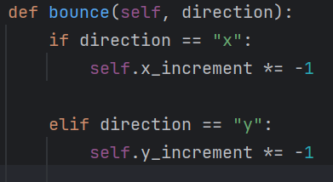
Step 7.5: Organizing our Code
Right now, our code works, but it’s a little disorganized, particularly with our ball object.
Writing ball.x_increment = ball.x_increment * -1 in our main.py program is a bit of a problem because that is code specific to the ball object that should be in the ball class
So, let’s move this code into a bounce() method in ball.py and call ball.bounce() instead of writing ball.x_increment = ball.x_increment * -1
The bounce method should have an input specifying what direction the ball is bouncing

Slide 18
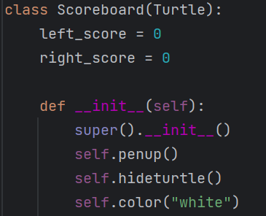
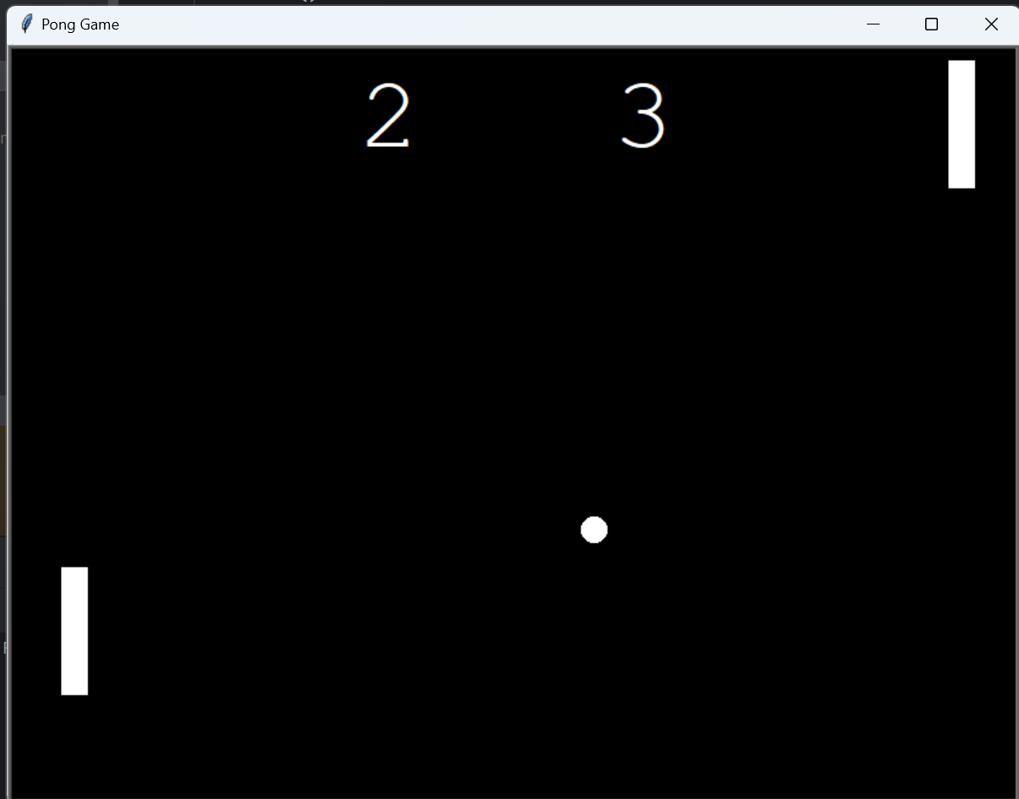
Step 8: Keep the Score
To track and write the score, let’s create a new Python file called scoreboard.py, where we create a Python class that inherits from Turtle
Next, we’ll need to create our __init__ function that calls super().__init__(), self.color(“white”), self.penup(), and self.hideturtle()
Then, let’s create 2 variables: left_score and right_score and we’ll set them equal to 0

Slide 19
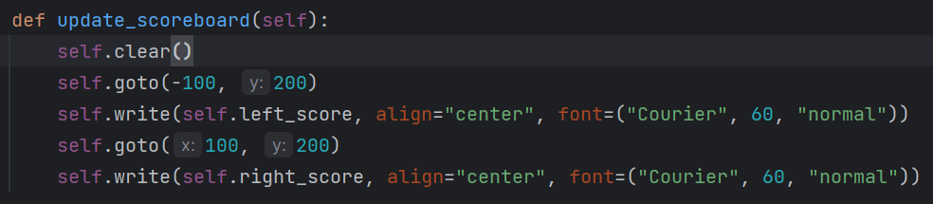
Updating the Scoreboard
Next, let’s create a method called update_scoreboard() where we write each player’s score with the scoreboard turtle
The left player’s score should be at position (-100, 200) and the right player’s score should be at (100, 200)
We should also write self.clear() at the top of the method so we don’t end up writing our numbers on top of previous numbers

Slide 20
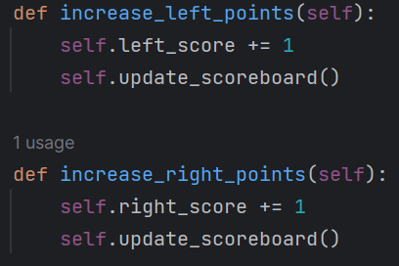
Increasing the Score
Now, we need to write an increase_right_points() and increase_left_points() function that increases the corresponding point value by 1 and calls self.update_screen()
We should also call self.update_screen() at the end of out __init__() function

Slide 21
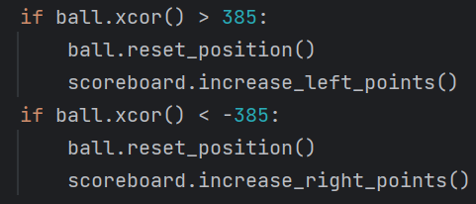
Using the Scoreboard in main.py
Next, let’s import and create a scoreboard object in our main.py file and call scoreboard.increase_left_points() and scoreboard.increase_right_points() when the left or right player scores respectively

Slide 22
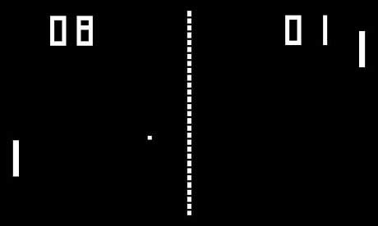
Finished with Pong!

Slide 23
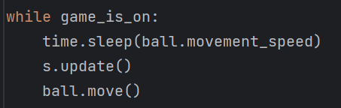
Bonus: Make the Ball Move Faster After Each Paddle Hit
If we want to make the game a little more difficult, we can increase the ball’s speed after a paddle hits the ball
To do this, we’ll change the value inside time.sleep() in our while loop
Bigger number → slower ball, smaller number → faster ball
In our while loop, we’ll replace 0.1 with a variable called ball.movement_speed
Next, we’ll create this movement_speed variable in our ball.py script and set it equal to 0.1

Slide 24
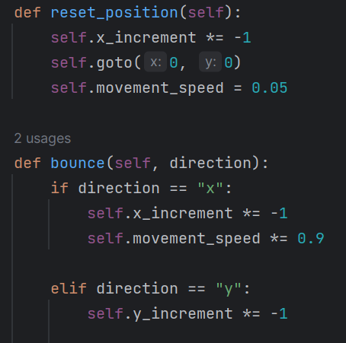
Then, in our bounce method, when the ball bounces in the x direction, we should multiply the ball’s movement speed by 0.9
Finally, when the ball resets position, we should reset the ball’s movement speed to 0.1

Slide 25
Other Things to Add to Pong
Make the screen look more like the original Pong (dashed line down the middle)
Make the game end and declare one player the winner if they score 15 points
Track the game’s high score using a file
Anything else you can think of!
Other Things to Add to Pong

